Slide 1
Introduction to Sockets Programming in C
using TCP/IP

Slide 2


Introduction
Computer Network
  hosts, routers,
Host
communication channels
Hosts run applications
Routers forward information
Packets: sequence of bytes
  contain control information
  e.g. destination host
Protocol is an agreement
  meaning of packets
  structure and size of packets
e.g. Hypertext Transfer Protocol (HTTP)
Router
Communication
channel

Slide 3
Protocol Families - TCP/IP
Several protocols for different problems
Protocol Suites or Protocol Families: TCP/IP
TCP/IP provides end-to-end connectivity specifying how data should be
  formatted,
  addressed,
  transmitted,
  routed, and
  received at the destination
can be used in the internet and in stand-alone private networks
it is organized into layers

Slide 4
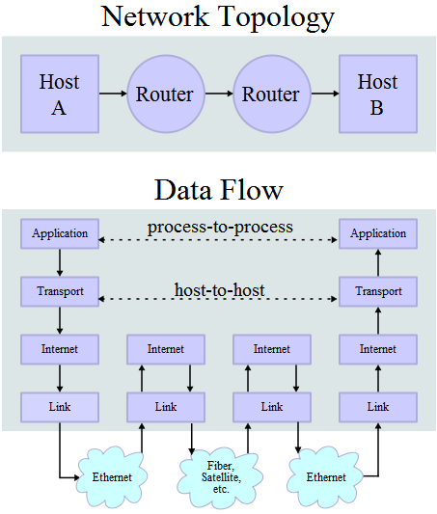
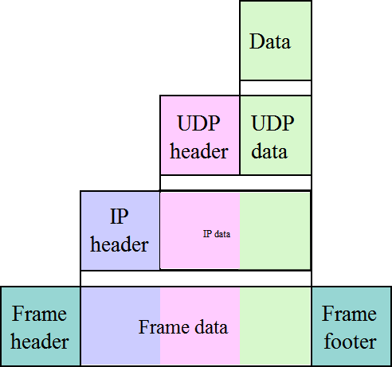
TCP/IP
*
FTP, SMTP, …
Transport Layer TCP or UDP
Network Layer IP
Communication Channels
* image is taken from “http://en.wikipedia.org/wiki/TCP/IP_model”

Slide 5

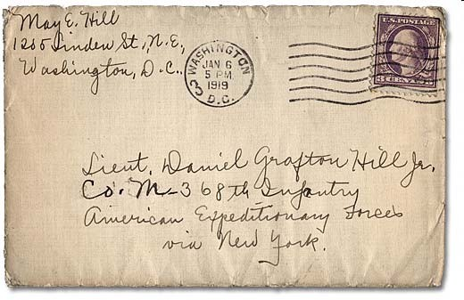
Internet Protocol (IP)
provides a datagram service
  packets are handled and delivered independently
best-effort protocol
  may loose, reorder or duplicate packets
each packet must contain an IP address of its destination

Slide 6
Addresses - IPv4
The 32 bits of an IPv4 address are broken into 4 octets, or 8 bit fields (0-255 value in decimal notation).
For networks of different size,
  the first one (for large networks) to three (for small networks) octets can be used to identify the network, while
  the rest of the octets can be used to identify the node on the network.
Range of addresses
1.0.0.0 to 127.255.255.255
128.0.0.0 to 191.255.255.255
192.0.0.0 to 223.255.255.255
224.0.0.0 to 239.255.255.255
240.0.0.0 to 255.255.255.255
7 24
Class A: 0 Network ID Host ID
14 16
Class B: 1 0 Network ID Host ID
21 8
Class C: 1 1 0 Network ID Host ID
28
Class D (multicast): 1 1 1 0 Multicast address
27
Class E (reserved): 1 1 1 1 0 unused

Slide 7
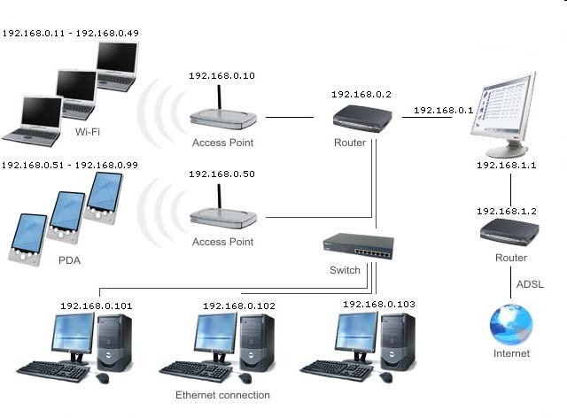
Local Area Network Addresses - IPv4

Slide 8
TCP vs UDP
Both use port numbers
  application-specific construct serving as a communication endpoint
  16-bit unsigned integer, thus ranging from 0 to 65535
 to provide end-to-end transport
UDP: User Datagram Protocol
  no acknowledgements
  no retransmissions
  out of order, duplicates possible
  connectionless, i.e., app indicates destination for each packet

Slide 9
TCP vs UDP
TCP: Transmission Control Protocol
  reliable byte-stream channel (in order, all arrive, no duplicates)
    similar to file I/O
  flow control
  connection-oriented
  bidirectional

Slide 10
TCP vs UDP
TCP is used for services with a large data capacity, and a persistent connection
UDP is more commonly used for quick lookups, and single use query-reply actions.
Some common examples of TCP and UDP with their default ports:
DNS lookup UDP 53
FTP TCP 21
HTTP TCP 80
POP3 TCP 110
Telnet TCP 23

Slide 11



Berkley Sockets
Universally known as Sockets
It is an abstraction through which an application may send and receive data
Provide generic access to interprocess communication services
  e.g. IPX/SPX, Appletalk, TCP/IP
Standard API for networking
Application
Application
Socket
Socket
TCP
TCP
IP
Channel
IP
Channel
IP
Host
Router
Host

Slide 12
Sockets
Uniquely identified by
  an internet address
  an end-to-end protocol (e.g. TCP or UDP)
  a port number
Two types of (TCP/IP) sockets
  Stream sockets (e.g. uses TCP)
    provide reliable byte-stream service
  Datagram sockets (e.g. uses UDP)
    provide best-effort datagram service
    messages up to 65.500 bytes

Slide 13
Sockets
Socket extend the convectional UNIX I/O facilities
  file descriptors for network communication
  extended the read and write system calls
Descriptor Table
internal data structure for file 1
0
1
2
Family: PF_INET
Service: SOCK_STREAM
Local_IP:
Remote_IP:
Local_Port:
Remote_Port:
…

Slide 14
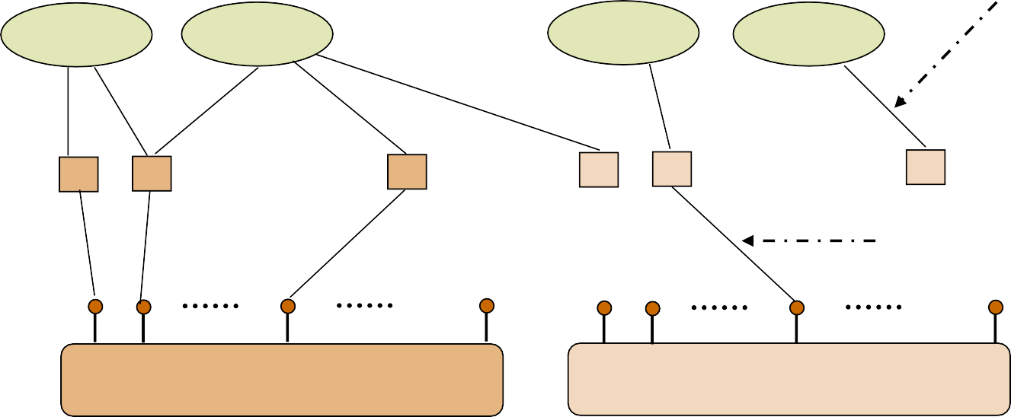
Sockets
Descriptor references
Applications
TCP sockets
UDP sockets
Sockets bound to ports
TCP ports
1 2
65535
1 2
65535 UDP ports
TCP
UDP
IP

Slide 15
Client-Server communication
Server
  passively waits for and responds to clients
  passive socket
Client
  initiates the communication
  must know the address and the port of the server
  active socket

Slide 16
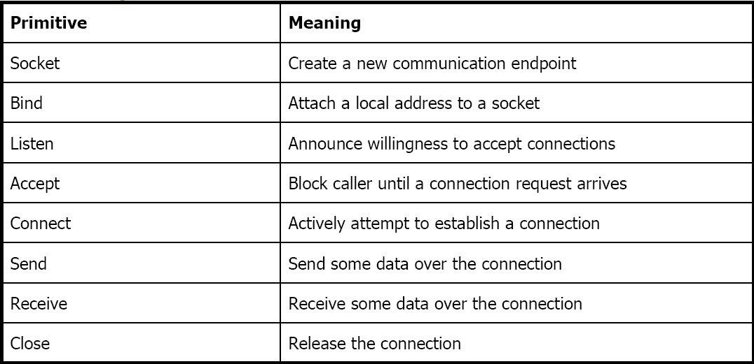
Sockets - Procedures

Slide 17
Client - Server Communication - Unix
Stream (e.g. TCP)
Datagram (e.g. UDP)
Server
Client
Server
Client
socket()
socket()
socket()
socket()
bind()
bind()
bind()
listen()
synchronization point
accept()
connect()
recv()
send()
recvfrom()
sendto()
send()
recv()
sendto()
recvfrom()
close()
close()
close()
close()

Slide 18
Socket creation in C: socket()
int sockid = socket(family, type, protocol);
  sockid: socket descriptor, an integer (like a file-handle)
  family: integer, communication domain, e.g.,
    PF_INET, IPv4 protocols, Internet addresses (typically used)
    PF_UNIX, Local communication, File addresses
  type: communication type
    SOCK_STREAM - reliable, 2-way, connection-based service

Slide 19
Socket creation in C: socket()
    SOCK_DGRAM - unreliable, connectionless, messages of maximum length
  protocol: specifies protocol
    IPPROTO_TCP IPPROTO_UDP
    usually set to 0 (i.e., use default protocol)
  upon failure returns -1
NOTE: socket call does not specify where data will be coming frfro, nor where it will be going to – it just creates the interface!

Slide 20
Client - Server Communication - Unix
Stream (e.g. TCP)
Datagram (e.g. UDP)
Server
Client
Server
Client
socket()
socket()
socket()
socket()
bind()
bind()
bind()
listen()
synchronization point
accept()
connect()
recv()
send()
recvfrom()
sendto()
send()
recv()
sendto()
recvfrom()
close()
close()
close()
close()

Slide 21
Socket close in C: close()
When finished using a socket, the socket should be closed
status = close(sockid);
  sockid: the file descriptor (socket being closed)
  status: 0 if successful, -1 if error
Closing a socket
  closes a connection (for stream socket)
  frees up the port used by the socket

Slide 22
Specifying Addresses
Socket API defines a generic data type for addresses:
struct sockaddr {
unsigned short sa_family; /* Address family (e.g. AF_INET) */
char sa_data[14]; /* Family-specific address information */
}
Particular form of the sockaddr used for TCP/IP addresses:
struct in_addr {
unsigned long s_addr; /* Internet address (32 bits) */
}

Slide 23
Specifying Addresses
struct sockaddr_in {
unsigned short sin_family; /* Internet protocol (AF_INET) */
unsigned short sin_port; /* Address port (16 bits) */
struct in_addr sin_addr;/* Internet address (32 bits) */
char sin_zero[8]; /* Not used */
}
Important: sockaddr_in can be casted to a sockaddr

Slide 24
Client - Server Communication - Unix
Stream (e.g. TCP)
Datagram (e.g. UDP)
Server
Client
Server
Client
socket()
socket()
socket()
socket()
bind()
bind()
bind()
listen()
synchronization point
accept()
connect()
recv()
send()
recvfrom()
sendto()
send()
recv()
sendto()
recvfrom()
close()
close()
close()
close()

Slide 25
Assign address to socket: bind()
associates and reserves a port for use by the socket
int status = bind(sockid, &addrport, size);
  sockid: integer, socket descriptor
  addrport: struct sockaddr, the (IP) address and port of the machine
    for TCP/IP server, internet address is usually set to INADDR_ANY, i.e., chooses any incoming interface
  size: the size (in bytes) of the addrport structure
  status: upon failure -1 is returned

Slide 26
bind()- Example with TCP
int sockid;
struct sockaddr_in addrport;
sockid = socket(PF_INET, SOCK_STREAM, 0);
addrport.sin_family = AF_INET; addrport.sin_port = htons(5100); addrport.sin_addr.s_addr = htonl(INADDR_ANY);
if(bind(sockid, (struct sockaddr *) &addrport, sizeof(addrport))!= -1) {
…}

Slide 27
Skipping the bind()
bind can be skipped for both types of sockets
Datagram socket:
  if only sending, no need to bind.
  The OS finds a port each time the socket sends a packet
  if receiving, need to bind
Stream socket:
  destination determined during connection setup
  don’t need to know port sending from (during connection setup, receiving end is informed of port)

Slide 28
Client - Server Communication - Unix
Stream (e.g. TCP)
Datagram (e.g. UDP)
Server
Client
Server
Client
socket()
socket()
socket()
socket()
bind()
bind()
bind()
listen()
synchronization point
accept()
connect()
recv()
send()
recvfrom()
sendto()
send()
recv()
sendto()
recvfrom()
close()
close()
close()
close()

Slide 29
Assign address to socket: bind()
Instructs TCP protocol implementation to listen for connections
int status = listen(sockid, queueLimit);
  sockid: integer, socket descriptor
  queuelen: integer, # of active participants that can “wait” for a connection
  status: 0 if listening, -1 if error
listen() is non-blocking: returns immediately
The listening socket (sockid)
  is never used for sending and receiving
  is used by the server only as a way to get new sockets

Slide 30
Client - Server Communication - Unix
Stream (e.g. TCP)
Datagram (e.g. UDP)
Server
Client
Server
Client
socket()
socket()
socket()
socket()
bind()
bind()
bind()
listen()
synchronization
accept()
point
connect()
recv()
send()
recvfrom()
sendto()
send()
recv()
sendto()
recvfrom()
close()
close()
close()
close()

Slide 31
Establish Connection: connect()
The client establishes a connection with the server by calling
connect()
int status = connect(sockid, &foreignAddr, addrlen);
  sockid: integer, socket to be used in connection
  foreignAddr: struct sockaddr: address of the passive participant
  addrlen: integer, sizeof(name)
  status: 0 if successful connect, -1 otherwise
connect() is blocking

Slide 32
Incoming Connection: accept()
The server gets a socket for an incoming client connection by calling
accept()
int s = accept(sockid, &clientAddr, &addrLen);
  s: integer, the new socket (used for data-transfer)
  sockid: integer, the orig. socket (being listened on)
  clientAddr: struct sockaddr, address of the active participant
    filled in upon return

Slide 33
Incoming Connection: accept()
The server gets a socket for an incoming client connection by calling
accept()
int s = accept(sockid, &clientAddr, &addrLen);
  s: integer, the new socket (used for data-transfer)
  sockid: integer, the orig. socket (being listened on)
  clientAddr: struct sockaddr, address of the active participant
    filled in upon return

Slide 34
Client - Server Communication - Unix
Stream (e.g. TCP)
Datagram (e.g. UDP)
Server
Client
Server
Client
socket()
socket()
socket()
socket()
bind()
bind()
bind()
listen()
synchronization point
accept()
connect()
recv()
send()
recvfrom()
sendto()
send()
recv()
sendto()
recvfrom()
close()
close()
close()
close()

Slide 35
Exchanging data with stream socket
int count = send(sockid, msg, msgLen, flags);
  msg: const void[], message to be transmitted
  msgLen: integer, length of message (in bytes) to transmit
  flags: integer, special options, usually just 0
  count: # bytes transmitted (-1 if error)

Slide 36
Exchanging data with stream socket
int count = recv(sockid, recvBuf, bufLen, flags);
  recvBuf: void[], stores received bytes
  bufLen: # bytes received
  flags: integer, special options, usually just 0
  count: # bytes received (-1 if error)
Calls are blocking
❑ returns only after data is sent / received

Slide 37
Exchanging data with datagram socket
int count = sendto(sockid, msg, msgLen, flags, &foreignAddr, addrlen);
  msg, msgLen, flags, count: same with send()
  foreignAddr: struct sockaddr, address of the destination
  addrLen: sizeof(foreignAddr)

Slide 38
Exchanging data with datagram socket
int count = recvfrom(sockid, recvBuf, bufLen, flags, &clientAddr, addrlen);
  recvBuf, bufLen, flags, count: same with recv()
  clientAddr: struct sockaddr, address of the client
  addrLen: sizeof(clientAddr)
Calls are blocking
  returns only after data is sent / received

Slide 39
Example - Echo
A client communicates with an “echo” server
The server simply echoes whatever it receives back to the client

Slide 40
Example - Echo using stream socket
The server starts by getting ready to receive client connections…
Client
Create a TCP socket
Establish connection
Communicate
Close the connection
Server
Create a TCP socket
Assign a port to socket
Set socket to listen
Repeatedly:
Accept new connection
Communicate
Close the connection

Slide 41
Example - Echo using stream socket
/* Create socket for incoming connections */
if ((servSock = socket(PF_INET, SOCK_STREAM, IPPROTO_TCP)) < 0) DieWithError("socket() failed");
Client
Create a TCP socket
Establish connection
Communicate
Close the connection
Server
Create a TCP socket
Assign a port to socket
Set socket to listen
Repeatedly:
Accept new connection
Communicate
Close the connection

Slide 42
echoServAddr.sin_family = AF_INET; /* Internet address family */ echoServAddr.sin_addr.s_addr = htonl(INADDR_ANY); /* Any incoming interface */ echoServAddr.sin_port = htons(echoServPort); /* Local port */
if (bind(servSock, (struct sockaddr *) &echoServAddr, sizeof(echoServAddr)) < 0) DieWithError("bind() failed");
Client
Create a TCP socket
Establish connection
Communicate
Close the connection
Server
Create a TCP socket
Assign a port to socket
Set socket to listen
Repeatedly:
Accept new connection
Communicate
Close the connection

Slide 43
echoServAddr.sin_family = AF_INET; /* Internet address family */ echoServAddr.sin_addr.s_addr = htonl(INADDR_ANY); /*Any incoming interface */
echoServAddr.sin_port = htons(echoServPort);
/* Local port */
if (bind(servSock, (struct sockaddr *) &echoServAddr, sizeof(echoServAddr)) < 0) DieWithError("bind() failed");

Slide 44
Example - Echo using stream socket
/* Mark the socket so it will listen for incoming connections */
if (listen(servSock, MAXPENDING) < 0) DieWithError("listen() failed");
Client
Create a TCP socket
Establish connection
Communicate
Close the connection
Server
Create a TCP socket
Assign a port to socket
Set socket to listen
Repeatedly:
Accept new connection
Communicate
Close the connection

Slide 45
for (;;) /* Run forever */
{
clntLen = sizeof(echoClntAddr);
if ((clientSock=accept(servSock,(struct sockaddr *)&echoClntAddr,&clntLen))<0) DieWithError("accept() failed");
...
Client
Create a TCP socket
Establish connection
Communicate
Close the connection
Server
Create a TCP socket
Assign a port to socket
Set socket to listen
Repeatedly:
Accept new connection
Communicate
Close the connection

Slide 46
Example - Echo using stream socket
Server is now blocked waiting for connection from a client
…
A client decides to talk to the server
Client
Create a TCP socket
Establish connection
Communicate
Close the connection
Server
Create a TCP socket
Assign a port to socket
Set socket to listen
Repeatedly:
Accept new connection
Communicate
Close the connection

Slide 47
Example - Echo using stream socket
/* Create a reliable, stream socket using TCP */
if ((clientSock = socket(PF_INET, SOCK_STREAM, IPPROTO_TCP)) < 0) DieWithError("socket() failed");
Client
Create a TCP socket
Establish connection
Communicate
Close the connection
Server
Create a TCP socket
Assign a port to socket
Set socket to listen
Repeatedly:
Accept new connection
Communicate
Close the connection

Slide 48
Example - Echo using stream socket
echoServAddr.sin_family = AF_INET; /* Internet address family */ echoServAddr.sin_addr.s_addr = inet_addr(echoservIP); /* Server IP address*/ echoServAddr.sin_port = htons(echoServPort); /* Server port */
if (connect(clientSock, (struct sockaddr *) &echoServAddr,
sizeof(echoServAddr)) < 0) DieWithError("connect() failed");
Client
Create a TCP socket
Establish connection
Communicate
Close the connection
Server
Create a TCP socket
Assign a port to socket
Set socket to listen
Repeatedly:
Accept new connection
Communicate
Close the connection

Slide 49
Example - Echo using stream socket
echoServAddr.sin_family = AF_INET;
/* Internet address family */ echoServAddr.sin_addr.s_addr = inet_addr(echoservIP);
/* Server IP address*/ echoServAddr.sin_port = htons(echoServPort);/* Server port */
if (connect(clientSock, (struct sockaddr *) &echoServAddr,sizeof(echoServAddr)) < 0) DieWithError("connect() failed");

Slide 50
Server’s accept procedure in now unblocked and returns client’s socket
for (;;) /* Run forever */
{
clntLen = sizeof(echoClntAddr);
if ((clientSock=accept(servSock,(struct sockaddr *)&echoClntAddr,&clntLen))<0) DieWithError("accept() failed");
...
Client
Create a TCP socket
Establish connection
Communicate
Close the connection
Server
Create a TCP socket
Assign a port to socket
Set socket to listen
Repeatedly:
Accept new connection
Communicate
Close the connection

Slide 51
Example - Echo using stream socket
echoStringLen = strlen(echoString); /* Determine input length */
/* Send the string to the server */
if (send(clientSock, echoString, echoStringLen, 0) != echoStringLen) DieWithError("send() sent a different number of bytes than expected");
Client
Create a TCP socket
Establish connection
Communicate
Close the connection
Server
Create a TCP socket
Assign a port to socket
Set socket to listen
Repeatedly:
Accept new connection
Communicate
Close the connection

Slide 52
Example - Echo using stream socket
echoStringLen = strlen(echoString);
/* Determine input length */
/* Send the string to the server */
if (send(clientSock, echoString, echoStringLen, 0) != echoStringLen) DieWithError("send() sent a different number of bytes than expected");

Slide 53
/* Receive message from client */
if ((recvMsgSize = recv(clntSocket, echoBuffer, RCVBUFSIZE, 0)) < 0) DieWithError("recv() failed");
/* Send received string and receive again until end of transmission */
while (recvMsgSize > 0) { /* zero indicates end of transmission */
if (send(clientSocket, echobuffer, recvMsgSize, 0) != recvMsgSize) DieWithError(“send() failed”);
if ((recvMsgSize = recv(clientSocket, echoBuffer, RECVBUFSIZE, 0)) < 0) DieWithError(“recv() failed”);
}
Client
Create a TCP socket
Establish connection
Communicate
Close the connection
Server
Create a TCP socket
Assign a port to socket
Set socket to listen
Repeatedly:
Accept new connection
Communicate
Close the connection

Slide 54
/* Receive message from client */
if ((recvMsgSize = recv(clntSocket, echoBuffer, RCVBUFSIZE, 0)) < 0) DieWithError("recv() failed");
/* Send received string and receive again until end of transmission */
while (recvMsgSize > 0) { /* zero indicates end of transmission */
if (send(clientSocket, echobuffer, recvMsgSize, 0) != recvMsgSize) DieWithError(“send() failed”);
if ((recvMsgSize = recv(clientSocket, echoBuffer, RECVBUFSIZE, 0)) < 0) DieWithError(“recv() failed”);
}

Slide 55
Example - Echo using stream socket
Similarly, the client receives the data from the server
Client
Create a TCP socket
Establish connection
Communicate
Close the connection
Server
Create a TCP socket
Assign a port to socket
Set socket to listen
Repeatedly:
Accept new connection
Communicate
Close the connection

Slide 56
Example - Echo using stream socket
close(clientSock);
close(clientSock);
Client
Create a TCP socket
Establish connection
Communicate
Close the connection
Server
Create a TCP socket
Assign a port to socket
Set socket to listen
Repeatedly:
  Accept new connection
  Communicate
  Close the connection

Slide 57
Example - Echo using stream socket
Server is now blocked waiting for connection from a client
…
Client
Create a TCP socket
Establish connection
Communicate
Close the connection
Server
Create a TCP socket
Assign a port to socket
Set socket to listen
Repeatedly:
Accept new connection
Communicate
Close the connection

Slide 58
Example - Echo using datagram socket
/* Create socket for sending/receiving datagrams */
if ((servSock = socket(PF_INET, SOCK_DGRAM, IPPROTO_UDP)) < 0) DieWithError("socket() failed");
/* Create a datagram/UDP socket */
if ((clientSock = socket(PF_INET, SOCK_DGRAM, IPPROTO_UDP)) < 0) DieWithError("socket() failed");
Client
Create a UDP socket
Assign a port to socket
Communicate
Close the socket
Server
Create a UDP socket
Assign a port to socket
Repeatedly
Communicate
▪

Slide 59
Example - Echo using datagram socket
echoServAddr.sin_family = AF_INET; /* Internet address family */ echoServAddr.sin_addr.s_addr = htonl(INADDR_ANY); /* Any incoming interface */ echoServAddr.sin_port = htons(echoServPort); /* Local port */
if (bind(servSock, (struct sockaddr *) &echoServAddr, sizeof(echoServAddr)) < 0) DieWithError("bind() failed");
echoClientAddr.sin_family = AF_INET; /* Internet address family */ echoClientAddr.sin_addr.s_addr = htonl(INADDR_ANY); /* Any incoming interface */ echoClientAddr.sin_port = htons(echoClientPort); /* Local port */
if(bind(clientSock,(struct sockaddr *)&echoClientAddr,sizeof(echoClientAddr))<0) DieWithError("connect() failed");
Client
Create a UDP socket
Assign a port to socket
Communicate
Close the socket
Server
Create a UDP socket
Assign a port to socket
Repeatedly
Communicate
▪

Slide 60
Example - Echo using datagram socket
echoServAddr.sin_family = AF_INET; echoServAddr.sin_addr.s_addr = inet_addr(echoservIP); echoServAddr.sin_port = htons(echoServPort);
/* Internet address family */
/* Server IP address*/
/* Server port */
echoStringLen = strlen(echoString); /* Determine input length */
/* Send the string to the server */
if (sendto( clientSock, echoString, echoStringLen, 0,
(struct sockaddr *) &echoServAddr, sizeof(echoServAddr))
!= echoStringLen)
DieWithError("send() sent a different number of bytes than expected");
Client
Create a UDP socket
Assign a port to socket
Communicate
Close the socket
Server
Create a UDP socket
Assign a port to socket
Repeatedly
Communicate
▪

Slide 61
Example - Echo using datagram socket
for (;;) /* Run forever */
{
clientAddrLen = sizeof(echoClientAddr)
/*Block until receive message from client*/
/* Set the size of the in-out parameter */
if ((recvMsgSize = recvfrom(servSock, echoBuffer, ECHOMAX, 0),
(struct sockaddr *) &echoClientAddr, sizeof(echoClientAddr))) < 0) DieWithError(“recvfrom() failed");
if (sendto(servSock, echobuffer, recvMsgSize, 0,
(struct sockaddr *) &echoClientAddr, sizeof(echoClientAddr))
!= recvMsgSize) DieWithError(“send() failed”);
}
Client
Create a UDP socket
Assign a port to socket
Communicate
Close the socket
Server
Create a UDP socket
Assign a port to socket
Repeatedly
Communicate
▪

Slide 62
Example - Echo using datagram socket
Similarly, the client receives the data from the server
Client
Create a UDP socket
Assign a port to socket
Communicate
Close the socket
Server
Create a UDP socket
Assign a port to socket
Repeatedly
Communicate
▪

Slide 63
Example - Echo using datagram socket
close(clientSock);
Client
Create a UDP socket
Assign a port to socket
Communicate
Close the socket
Server
Create a UDP socket
Assign a port to socket
Repeatedly
Communicate
▪

Slide 64
Client - Server Communication - Unix
Stream (e.g. TCP)
Datagram (e.g. UDP)
Server
Client
Server
Client
socket()
socket()
socket()
socket()
bind()
bind()
bind()
listen()
synchronization point
accept()
connect()
recv()
send()
recvfrom()
sendto()
send()
recv()
sendto()
recvfrom()
close()
close()
close()
close()

Slide 65
Constructing Messages - Encoding Data
Client wants to send two integers x and y to server
1st Solution: Character Encoding
  e.g. ASCII
 the same representation is used to print or display them to screen
 allows sending arbitrarily large numbers (at least in principle)
e.g. x = 17,998,720 and y = 47,034,615
1
7
9
9
8
7
2
0
_
4
7
0
3
4
6
1
5
_
49 | 55 | 57 | 57 | 56 | 55 | 50 | 48 | 32 | 52 | 55 | 48 | 51 | 52 | 54 | 49 | 53 | 32
sprintf(msgBuffer, “%d %d ”, x, y); send(clientSocket, strlen(msgBuffer), 0);

Slide 66
Constructing Messages - Encoding Data
Pitfalls
  the second delimiter is required
    otherwise the server will not be able to separate it from whatever it follows
  msgBuffer must be large enough
  strlen counts only the bytes of the message
    not the null at the end of the string
 This solution is not efficient
 each digit can be represented using 4 bits, instead of one byte
 it is inconvenient to manipulate numbers
2nd Solution: Sending the values of x and y

Slide 67
Constructing Messages - Encoding Data
2nd Solution: Sending the values of x and y
  pitfall: native integer format
 a protocol is used
    how many bits are used for each integer
    what type of encoding is used (e.g. two’s complement, sign/magnitude, unsigned)
1st Implementation
typedef struct { int x,y;
} msgStruct;
…
msgStruct.x = x; msgStruct.y = y; send(clientSock, &msgStruct, sizeof(msgStruct), 0);
2nd Implementation
send(clientSock, &x, sizeof(x)), 0); send(clientSock, &y, sizeof(y)), 0);
2nd implementation works in any case?

Slide 68
Constructing Messages - Byte Ordering
Address and port are stored as integers
  u_short sin_port; (16 bit)
  in_addr sin_addr; (32 bit)
Problem:
  different machines / OS’s use different word orderings
    little-endian: lower bytes first
    big-endian: higher bytes first
  these machines may communicate with one another over the network
n
Little-Endian machine
Big-Endia
machine
12.40.119.128
128.119.40.12
128 | 119 | 40 | 12
128 | 119 | 40 | 12

Slide 69
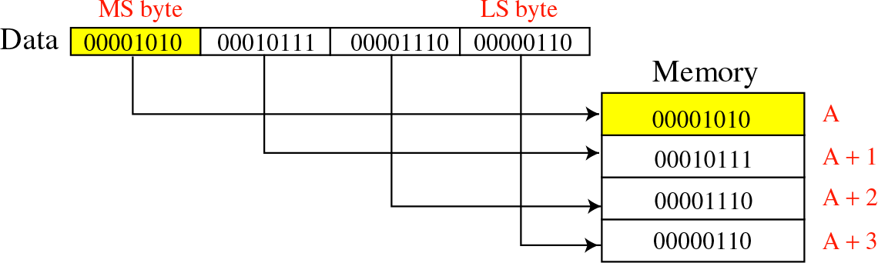
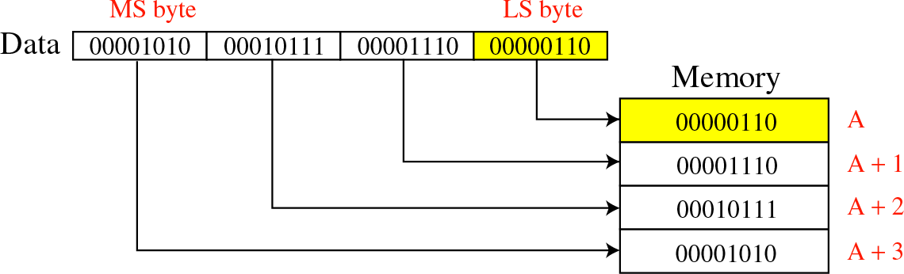
Constructing Messages - Byte Ordering
Big-Endian:
Little-Endian:

Slide 70
Constructing Messages - Byte Ordering -
Solution: Network Byte Ordering
Host Byte-Ordering: the byte ordering used by a host (big or little)
Network Byte-Ordering: the byte ordering used by the network – always big-endian
u_long htonl(u_long x);
u_short htons(u_short x);
u_long ntohl(u_long x);
u_short ntohs(u_short x);
On big-endian machines, these routines do nothing
On little-endian machines, they reverse the byte order
an Littl mach
e-Endian
ine
12
40
119
128
128 | 119 | 40 | 12
Big-Endi
machine
128
.119.4
0.12
128
.119.4
0.12
htonl
ntohl
128 | 119 | 40 | 12
128 | 119 | 40 | 12

Slide 71
Constructing Messages - Byte Ordering -
Example
Client
unsigned short clientPort, message; unsigned int messageLenth;
servPort = 1111;
message = htons(clientPort); messageLength = sizeof(message);
if (sendto( clientSock, message, messageLength, 0,
(struct sockaddr *) &echoServAddr, sizeof(echoServAddr))
!= messageLength)
DieWithError("send() sent a different number of bytes than expected");
Server
unsigned short clientPort, rcvBuffer; unsigned int recvMsgSize ;
if ( recvfrom(servSock, &rcvBuffer, sizeof(unsigned int), 0),
(struct sockaddr *) &echoClientAddr, sizeof(echoClientAddr)) < 0) DieWithError(“recvfrom() failed");
clientPort = ntohs(rcvBuffer);
printf (“Client’s port: %d”, clientPort);

Slide 72
Constructing Messages - Alignment and Padding
consider the following 12 byte structure
typedef struct { int x;
short x2; int y; short y2;
} msgStruct;
After compilation it will be a 14 byte structure!
Why? € Alignment!
Remember the following rules:
  data structures are maximally aligned, according to the size of the largest native integer
  other multibyte fields are aligned to their size, e.g., a four-byte integer’s address will be divisible by four
x | x2 | y | y2
x | x2 | [pad] | y | y2
4 bytes 2 bytes 4 bytes 2 bytes
This can be avoided
  include padding to data structure
  reorder fields
4 bytes 2 bytes 2 bytes
4 bytes
2 bytes
typedef struct { int x;
short x2; char pad[2]; int y;
short y2;
} msgStruct;
typedef struct { int x;
int y; short x2; short y2;
} msgStruct;

Slide 73
Constructing Messages - Framing and Parsing
Framing is the problem of formatting the information so that the receiver can parse messages
Parse means to locate the beginning and the end of message
This is easy if the fields have fixed sizes
  e.g., msgStruct
For text-string representations is harder
  Solution: use of appropriate delimiters
  caution is needed since a call of recv may return the messages sent by multiple calls of send

Slide 74
Socket Options
getsockopt and setsockopt allow socket options values to be queried and set, respectively
int getsockopt (sockid, level, optName, optVal, optLen);
  sockid: integer, socket descriptor
  level: integer, the layers of the protocol stack (socket, TCP, IP)
  optName: integer, option
  optVal: pointer to a buffer; upon return it contains the value of the specified option

Slide 75
Socket Options
  optLen: integer, in-out parameter it returns -1 if an error occured
int setsockopt (sockid, level, optName, optVal, optLen);
  optLen is now only an input parameter

Slide 76
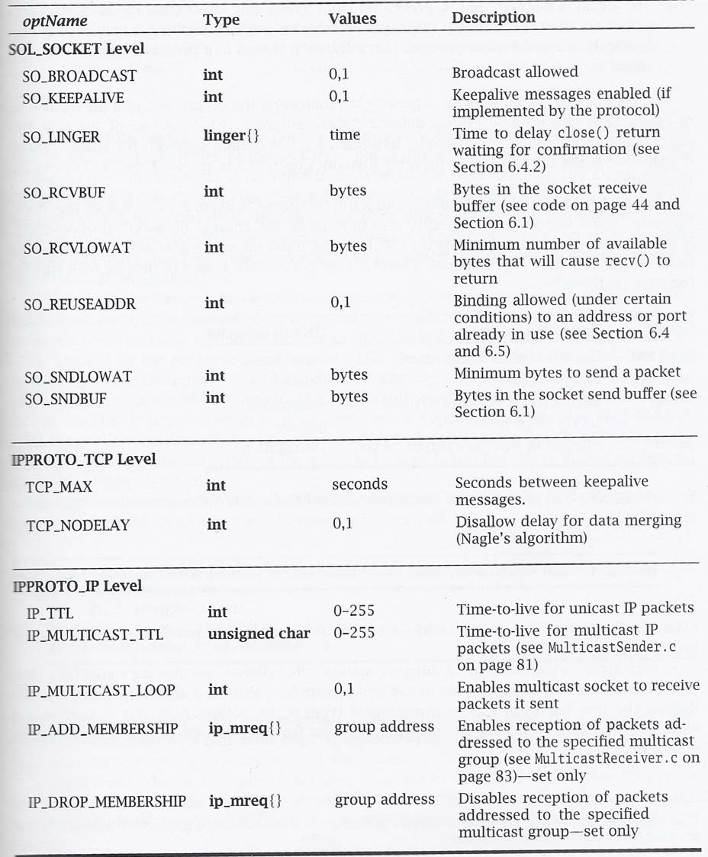
Socket Options
- Table

Slide 77
Socket Options - Example
Fetch and then double the current number of bytes in the socket’s receive buffer
int rcvBufferSize; int sockOptSize;…
77

Slide 78
Socket Options - Example
/* Retrieve and print the default buffer size */
sockOptSize = sizeof(recvBuffSize);
if (getsockopt(sock, SOL_SOCKET, SO_RCVBUF, &rcvBufferSize, &sockOptSize) < 0) DieWithError(“getsockopt() failed”);
printf(“Initial Receive Buffer Size: %d\n”, rcvBufferSize);
78

Slide 79
Socket Options - Example
/* Double the buffer size */
recvBufferSize *= 2;
/* Set the buffer size to new value */
if (setsockopt(sock, SOL_SOCKET, SO_RCVBUF,
&rcvBufferSize,
sizeof(rcvBufferSize)) < 0)
DieWithError(“getsockopt() failed”);
79

Slide 80
Socket Options - Example
Fetch and then double the current number of bytes in the socket’s receive buffer
int rcvBufferSize; int sockOptSize;
…
/* Retrieve and print the default buffer size */
sockOptSize = sizeof(recvBuffSize);
if (getsockopt(sock, SOL_SOCKET, SO_RCVBUF, &rcvBufferSize, &sockOptSize) < 0) DieWithError(“getsockopt() failed”);
printf(“Initial Receive Buffer Size: %d\n”, rcvBufferSize);
/* Double the buffer size */
recvBufferSize *= 2;
/* Set the buffer size to new value */
if (setsockopt(sock, SOL_SOCKET, SO_RCVBUF, &rcvBufferSize, sizeof(rcvBufferSize)) < 0)
DieWithError(“getsockopt() failed”);
80

Slide 81
Dealing with blocking calls
Many of the functions we saw block (by default) until a certain event
  accept: until a connection comes in
  connect: until the connection is established
  recv, recvfrom: until a packet (of data) is received
    what if a packet is lost (in datagram socket)?
  send: until data are pushed into socket’s buffer
  sendto: until data are given to the network subsystem
81

Slide 82
Dealing with blocking calls
For simple programs, blocking is convenient
What about more complex programs?
  multiple connections
  simultaneous sends and receives
  simultaneously doing non-networking processing
82

Slide 83
Dealing with blocking calls
Non-blocking Sockets
Asynchronous I/O
Timeouts
83

Slide 84
Non-blocking Sockets
If an operation can be completed immediately, success is returned; otherwise, a failure is returned (usually -1)
  errno is properly set, to distinguish this (blocking) failure from other - (EINPROGRESS for connect, EWOULDBLOCK for the other)
84

Slide 85
Non-blocking Sockets
1st Solution: int fcntl (sockid, command, argument);
  sockid: integer, socket descriptor
  command: integer, the operation to be performed (F_GETFL, F_SETFL)
  argument: long, e.g. O_NONBLOCK
 fcntl (sockid, F_SETFL, O_NONBLOCK);
2nd Solution: flags parameter of send, recv, sendto, recvfrom
  MSG_DONTWAIT
  not supported by all implementations
85

Slide 86
Signals
Provide a mechanism for operating system to notify processes that certain events occur
  e.g., the user typed the “interrupt” character, or a timer expired
signals are delivered asynchronously
upon signal delivery to program
  it may be ignored, the process is never aware of it
  the program is forcefully terminated by the OS
  a signal-handling routine, specified by the program, is executed
86

Slide 87
Signals
    this happens in a different thread
  the signal is blocked, until the program takes action to allow its delivery
    each process (or thread) has a corresponding mask
Each signal has a default behavior
  e.g. SIGINT (i.e., Ctrl+C) causes termination
  it can be changed using sigaction()
Signals can be nested (i.e., while one is being handled another is delivered)
87

Slide 88
Signals
int sigaction(whichSignal, &newAction, &oldAction);
  whichSignal: integer
  newAction: struct sigaction, defines the new behavior
  oldAction: struct sigaction, if not NULL, then previous behavior is copied
  it returns 0 on success, -1 otherwise
struct sigaction {
void (*sa_handler)(int); /* Signal handler */
sigset_t sa_mask; /* Signals to be blocked during handler execution */ int sa_flags; /* Flags to modify default behavior */
};
sa_handler determines which of the first three possibilities occurs when signal is delivered, i.e., it is not masked
  SIG_IGN, SIG_DFL, address of a function
sa_mask specifies the signals to be blocked while handling whichSignal
  whichSignal is always blocked
  it is implemented as a set of boolean flags
int sigemptyset (sigset_t *set); /* unset all the flags */
int sigfullset (sigset_t *set); /* set all the flags */
int sigaddset(sigset_t *set, int whichSignal); /* set individual flag */
int sigdelset(sigset_t *set, int whichSignal); /* unset individual flag */
88

Slide 89
Signals - Example
#include <stdio.h> #include <signal.h> #include <unistd.h>
void DieWithError(char *errorMessage);
void InterruptSignalHandler(int signalType);
int main (int argc, char *argv[]) {
struct sigaction handler;
handler.sa_handler = InterruptSignalHandler;
if (sigfillset(&handler.sa_mask) < 0) DieWithError (“sigfillset() failed”);
handler.sa_flags = 0;
if (sigaction(SIGINT, &handler, 0) < 0) DieWithError (“sigaction() failed”);
for(;;) pause(); exit(0);
}
/* Signal handler specification structure */
/* Set handler function */
/* Create mask that masks all signals */
/* Set signal handling for interrupt signals */
/* Suspend program until signal received */
void InterruptHandler (int signalType) {
printf (“Interrupt received. Exiting program.\n); exit(1);
}
89

Slide 90
Asynchronous I/O
 Non-blocking sockets require “polling”
 With asynchronous I/O the operating system informs the program when a socket call is completed
the SIGIO signal is delivered to the process, when some I/O-related event occurs on the socket
Three steps:
/* i. inform the system of the desired disposition of the signal */ struct sigaction handler; handler.sa_handler = SIGIOHandler;
if (sigfillset(&handler.sa_mask) < 0) DiewithError(“…”); handler.sa_flags = 0;
if (sigaction(SIGIO, &handler, 0) < 0) DieWithError(“…”);
/* ii. ensure that signals related to the socket will be delivered to this process */
if (fcntl(sock, F_SETOWN, getpid()) < 0) DieWithError();
/* iii. mark the socket as being primed for asynchronous I/O */
if (fcntl(sock, F_SETFL, O_NONBLOCK | FASYNC) < 0) DieWithError();
90

Slide 91
Timeouts
Using asynchronous I/O the operating system informs the program for the occurrence of an I/O related event
  what happens if a UPD packet is lost?
We may need to know if something doesn’t happen after some time
unsigned int alarm (unsigned int secs);
  starts a timer that expires after the specified number of seconds (secs)
  returns
    the number of seconds remaining until any previously scheduled alarm was due to be delivered,
    or zero if there was no previously scheduled alarm
  process receives SIGALARM signal when timer expires and errno is set to
EINTR
91

Slide 92
Asynchronous I/O - Example
/* Inform the system of the desired disposition of the signal */ struct sigaction myAction; myAction.sa_handler = CatchAlarm;
if (sigfillset(&myAction.sa_mask) < 0) DiewithError(“…”); myAction.sa_flags = 0;
if (sigaction(SIGALARM, &handler, 0) < 0) DieWithError(“…”);
/* Set alarm */
alarm(TIMEOUT_SECS);
/* Call blocking receive */
if (recvfrom(sock, echoBuffer, ECHOMAX, 0, … ) < 0) { if (errno = EINTR) … /*Alarm went off */
else DieWithError(“recvfrom() failed”);
}
92

Slide 93
Iterative Stream Socket Server
Handles one client at a time
Additional clients can connect while one is being served
  connections are established
  they are able to send requests
but, the server will respond after it finishes with the first client
 Works well if each client required a small, bounded amount of work by the server
 otherwise, the clients experience long delays
93

Slide 94
Iterative Server - Example: echo using stream socket
#include <stdio.h> /* for printf() and fprintf() */
#include <sys/socket.h> /* for socket(), bind(), connect(), recv() and send() */
#include <arpa/inet.h> #include <stdlib.h> #include <string.h> #include <unistd.h>
/* for sockaddr_in and inet_ntoa() */
/* for atoi() and exit() */
/* for memset() */
/* for close() */
#define MAXPENDING 5 /* Maximum outstanding connection requests */
void DieWithError(char *errorMessage); /* Error handling function */
void HandleTCPClient(int clntSocket); /* TCP client handling function */
int main(int argc, char *argv[]) { int servSock;
int clntSock;
/* Socket descriptor for server */
/* Socket descriptor for client */
struct sockaddr_in echoServAddr; /* Local address */ struct sockaddr_in echoClntAddr; /* Client address */
unsigned short echoServPort; unsigned int clntLen;
/* Server port */
/* Length of client address data structure */
if (argc != 2) { /* Test for correct number of arguments */ fprintf(stderr, "Usage: %s <Server Port>\n", argv[0]); exit(1);
}
echoServPort = atoi(argv[1]); /* First arg: local port */
/* Create socket for incoming connections */
if ((servSock = socket(PF_INET, SOCK_STREAM, IPPROTO_TCP)) < 0) DieWithError("socket() failed");
...
94

Slide 95
Iterative Server - Example: echo using stream socket
...
/* Construct local address structure */ memset(&echoServAddr, 0, sizeof(echoServAddr)); echoServAddr.sin_family = AF_INET;
/* Zero out structure */
/* Internet address family */
echoServAddr.sin_addr.s_addr = htonl(INADDR_ANY); /* Any incoming interface */
echoServAddr.sin_port = htons(echoServPort); /* Local port */
/* Bind to the local address */
if (bind(servSock, (struct sockaddr *) &echoServAddr, sizeof(echoServAddr)) < 0) DieWithError("bind() failed");
/* Mark the socket so it will listen for incoming connections */ if (listen(servSock, MAXPENDING) < 0)
DieWithError("listen() failed");
for (;;) /* Run forever */
{
/* Set the size of the in-out parameter */ clntLen = sizeof(echoClntAddr);
/* Wait for a client to connect */
if ((clntSock = accept(servSock, (struct sockaddr *) &echoClntAddr,
&clntLen)) < 0) DieWithError("accept() failed");
/* clntSock is connected to a client! */
printf("Handling client %s\n", inet_ntoa(echoClntAddr.sin_addr)); HandleTCPClient(clntSock);
}
/* NOT REACHED */
}
95

Slide 96
Iterative Server - Example: echo using stream socket
#define RCVBUFSIZE 32 /* Size of receive buffer */
void HandleTCPClient(int clntSocket)
{
char echoBuffer[RCVBUFSIZE]; int recvMsgSize;
/* Buffer for echo string */
/* Size of received message */
/* Receive message from client */
if ((recvMsgSize = recv(clntSocket, echoBuffer, RCVBUFSIZE, 0)) < 0) DieWithError("recv() failed");
/* Send received string and receive again until end of transmission */ while (recvMsgSize > 0) /* zero indicates end of transmission */
{
/* Echo message back to client */
if (send(clntSocket, echoBuffer, recvMsgSize, 0) != recvMsgSize) DieWithError("send() failed");
/* See if there is more data to receive */
if ((recvMsgSize = recv(clntSocket, echoBuffer, RCVBUFSIZE, 0)) < 0) DieWithError("recv() failed");
}
close(clntSocket); /* Close client socket */
}
96

Slide 97
Multitasking - Per-Client Process
For each client connection request, a new process is created to handle the communication
int fork();
  a new process is created, identical to the calling process, except for its process ID and the return value it receives from fork()
  returns 0 to child process, and the process ID of the new child to parent
Caution:
  when a child process terminates, it does not automatically disappears
  use waitpid() to parent in order to “harvest” zombies
97

Slide 98
Multitasking - Per-Client Process
- Example: echo using stream socket
#include <sys/wait.h> /* for waitpid() */
int main(int argc, char *argv[]) { int servSock;
int clntSock;
unsigned short echoServPort;
pid_t processID;
unsigned int childProcCount = 0;
/* Socket descriptor for server */
/* Socket descriptor for client */
/* Server port */
/* Process ID from fork()*/
/* Number of child processes */
if (argc != 2) { /* Test for correct number of arguments */ fprintf(stderr, "Usage: %s <Server Port>\n", argv[0]); exit(1);
}
echoServPort = atoi(argv[1]); /* First arg: local port */
servSock = CreateTCPServerSocket(echoServPort); for (;;) { /* Run forever */
clntSock = AcceptTCPConnection(servSock);
if ((processID = fork()) < 0) DieWithError (“fork() failed”); /* Fork child process */
else if (processID = 0) { close(servSock); HandleTCPClient(clntSock); exit(0);
}
/* This is the child process */
/* child closes listening socket */
/* child process terminates */
close(clntSock); childProcCount++;
/* parent closes child socket */
/* Increment number of outstanding child processes */
...
98

Slide 99
Multitasking - Per-Client Process
- Example: echo using stream socket
...
while (childProcCount) {
processID = waitpid((pid_t) -1, NULL, WHOANG); if (processID < 0) DieWithError (“...”);
else if (processID == 0) break; else childProcCount--;
}
/* Clean up all zombies */
/* Non-blocking wait */
/* No zombie to wait */
/* Cleaned up after a child */
}
/* NOT REACHED */
}
99

Slide 100
Multitasking - Per-Client Thread
 Forking a new process is expensive
duplicate the entire state (memory, stack, file/socket descriptors, …)
 Threads decrease this cost by allowing multitasking within the same process
threads share the same address space (code and data)
An example is provided using POSIX Threads
100

Slide 101
Multitasking - Per-Client Thread
- Example: echo using stream socket
#include <pthread.h>
/* for POSIX threads */
void *ThreadMain(void *arg)
/* Main program of a thread */
struct ThreadArgs { int clntSock;
};
/* Structure of arguments to pass to client thread */
/* socket descriptor for client */
int main(int argc, char *argv[]) { int servSock;
int clntSock;
unsigned short echoServPort;
pthread_t threadID;
struct ThreadArgs *threadArgs;
/* Socket descriptor for server */
/* Socket descriptor for client */
/* Server port */
/* Thread ID from pthread_create()*/
/* Pointer to argument structure for thread */
if (argc != 2) { /* Test for correct number of arguments */ fprintf(stderr, "Usage: %s <Server Port>\n", argv[0]); exit(1);
}
echoServPort = atoi(argv[1]); /* First arg: local port */
servSock = CreateTCPServerSocket(echoServPort); for (;;) { /* Run forever */
clntSock = AcceptTCPConnection(servSock);
/* Create separate memory for client argument */
if ((threadArgs = (struct ThreadArgs *) malloc(sizeof(struct ThreadArgs)))) == NULL) DieWithError(“…”);
threadArgs -> clntSock = clntSock;
/* Create client thread */
if (pthread_create (&threadID, NULL, ThreadMain, (void *) threadArgs) != 0) DieWithError(“…”);
}
/* NOT REACHED */
}
101

Slide 102
Multitasking - Per-Client Thread
- Example: echo using stream socket
void *ThreadMain(void *threadArgs)
{
int clntSock; /* Socket descriptor for client connection */
pthread_detach(pthread_self()); /* Guarantees that thread resources are deallocated upon return */
/* Extract socket file descriptor from argument */
clntSock = ((struct ThreadArgs *) threadArgs) -> clntSock; free(threadArgs); /* Deallocate memory for argument */
HandleTCPClient(clntSock); return (NULL);
}
102

Slide 103
Multitasking - Constrained
Both process and thread incurs overhead
  creation, scheduling and context switching
As their numbers increases
  this overhead increases
  after some point it would be better if a client was blocked
Solution: Constrained multitasking. The server:
  begins, creating, binding and listening to a socket
  creates a number of processes, each loops forever and accept connections from the same socket
  when a connection is established
    the client socket descriptor is returned to only one process
    the other remain blocked
103

Slide 104
Multitasking - Constrained
- Example: echo using stream socket
void ProcessMain(int servSock); /* Main program of process */
int main(int argc, char *argv[]) { int servSock;
unsigned short echoServPort; pid_t processID;
unsigned int processLimit; unsigned int processCt;
/* Socket descriptor for server*/
/* Server port */
/* Process ID */
/* Number of child processes to create */
/* Process counter */
if (argc != 3) { /* Test for correct number of arguments */ fprintf(stderr,"Usage: %s <SERVER PORT> <FORK LIMIT>\n", argv[0]); exit(1);
}
echoServPort = atoi(argv[1]); /* First arg: local port */
processLimit = atoi(argv[2]); /* Second arg: number of child processes */
servSock = CreateTCPServerSocket(echoServPort);
for (processCt=0; processCt < processLimit; processCt++)
if ((processID = fork()) < 0) DieWithError("fork() failed"); else if (processID == 0) ProcessMain(servSock);
/* Fork child process */
/* If this is the child process */
exit(0); /* The children will carry on */
}
void ProcessMain(int servSock) {
int clntSock; /* Socket descriptor for client connection */
for (;;) { /* Run forever */
clntSock = AcceptTCPConnection(servSock);
printf("with child process: %d\n", (unsigned int) getpid()); HandleTCPClient(clntSock);
}
}
104

Slide 105
Multiplexing
So far, we have dealt with a single I/O channel
We may need to cope with multiple I/O channels
  e.g., supporting the echo service over multiple ports
Problem: from which socket the server should accept connections or receive messages?
  it can be solved using non-blocking sockets
 but it requires polling
Solution: select()
  specifies a list of descriptors to check for pending I/O operations
  blocks until one of the descriptors is ready
  returns which descriptors are ready
105

Slide 106
Multiplexing
int select (maxDescPlus1, &readDescs, &writeDescs, &exceptionDescs, &timeout);
  maxDescsPlus1: integer, hint of the maximum number of descriptors
  readDescs: fd_set, checked for immediate input availability
  writeDescs: fd_set, checked for the ability to immediately write data
  exceptionDescs: fd_set, checked for pending exceptions
  timeout: struct timeval, how long it blocks (NULL € forever)
returns the total number of ready descriptors, -1 in case of error
changes the descriptor lists so that only the corresponding positions are set
int FD_ZERO (fd_set *descriptorVector);
int FD_CLR (int descriptor, fd_set *descriptorVector); int FD_SET (int descriptor, fd_set *descriptorVector);
/* removes all descriptors from vector */
/* remove descriptor from vector */
/* add descriptor to vector */
/* vector membership check */
int FD_ISSET (int descriptor, fd_set *descriptorVector);
struct timeval {
time_t tv_sec; /* seconds */ time_t tv_usec; /* microseconds */
};
106

Slide 107
Multiplexing - Example: echo using stream socket
#include <sys/time.h> /* for struct timeval {} */
int | main(int argc, char *argv[])
{
 | int *servSock; | /* | Socket descriptors for server */
 | int maxDescriptor; | /* | Maximum socket descriptor value */
 | fd_set sockSet; | /* | Set of socket descriptors for select() */
 | long timeout; | /* | Timeout value given on command-line */
 | struct timeval selTimeout; | /* | Timeout for select() */
 | int running = 1; | /* | 1 if server should be running; 0 otherwise */
 | int noPorts; | /* | Number of port specified on command-line */
 | int port; | /* | Looping variable for ports */
 | unsigned short portNo; | /* | Actual port number */
if (argc < 3) { /* Test for correct number of arguments */ fprintf(stderr, "Usage: %s <Timeout (secs.)> <Port 1> ...\n", argv[0]); exit(1);
}
timeout = atol(argv[1]); noPorts = argc - 2;
/* First arg: Timeout */
/* Number of ports is argument count minus 2 */
servSock = (int *) malloc(noPorts * sizeof(int)); /* Allocate list of sockets for incoming connections */ maxDescriptor = -1; /* Initialize maxDescriptor for use by select() */
for (port = 0; port < noPorts; port++) { portNo = atoi(argv[port + 2]);
/* Create list of ports and sockets to handle ports */
/* Add port to port list. Skip first two arguments */
servSock[port] = CreateTCPServerSocket(portNo); /* Create port socket */
if (servSock[port] > maxDescriptor) /* Determine if new descriptor is the largest */ maxDescriptor = servSock[port];
}
...
107

Slide 108
Multiplexing - Example: echo using stream socket
printf("Starting server: Hit return to shutdown\n"); while (running) {
/* Zero socket descriptor vector and set for server sockets */
/* This must be reset every time select() is called */ FD_ZERO(&sockSet);
FD_SET(STDIN_FILENO, &sockSet); /* Add keyboard to descriptor vector */ for (port = 0; port < noPorts; port++) FD_SET(servSock[port], &sockSet);
/* Timeout specification */
/* This must be reset every time select() is called */ selTimeout.tv_sec = timeout; /* timeout (secs.) */ selTimeout.tv_usec = 0; /* 0 microseconds */
/* Suspend program until descriptor is ready or timeout */
if (select(maxDescriptor + 1, &sockSet, NULL, NULL, &selTimeout) == 0) printf("No echo requests for %ld secs...Server still alive\n", timeout);
else {
if (FD_ISSET(0, &sockSet)) { /* Check keyboard */ printf("Shutting down server\n");
getchar(); running = 0;
}
for (port = 0; port < noPorts; port++)
if (FD_ISSET(servSock[port], &sockSet)) { printf("Request on port %d: ", port); HandleTCPClient(AcceptTCPConnection(servSock[port]));
}
}
}
for (port = 0; port < noPorts; port++) close(servSock[port]); /* Close sockets */ free(servSock); /* Free list of sockets */
exit(0);
}
108

Slide 109
Multiple Recipients
So far, all sockets have dealt with unicast communication
  i.e., an one-to-one communication, where one copy (“uni”) of the data is sent (“cast”)
what if we want to send data to multiple recipients?
1st Solution: unicast a copy of the data to each recipient
 inefficient, e.g.,
consider we are connected to the internet through a 3Mbps line
a video server sends 1-Mbps streams
then, server can support only three clients simultaneously
2nd Solution: using network support
  broadcast, all the hosts of the network receive the message
  multicast, a message is sent to some subset of the host
for IP: only UDP sockets are allowed to broadcast and multicast
109

Slide 110
Multiple Recipients - Broadcast
Only the IP address changes
Local broadcast: to address 255.255.255.255
  send the message to every host on the same broadcast network
  not forwarded by the routers
Directed broadcast:
  for network identifier 169.125 (i.e., with subnet mask 255.255.0.0)
  the directed broadcast address is 169.125.255.255
No network-wide broadcast address is available
  why?
 In order to use broadcast the options of socket must change:
int broadcastPermission = 1;
setsockopt(sock, SOL_SOCKET, SO_BROADCAST, (void*) &broadcastPermission, sizeof(broadcastPermission));
110

Slide 111
Multiple Recipients - Multicast
Using class D addresses
  range from 224.0.0.0 to 239.255.255.255
hosts send multicast requests for specific addresses
a multicast group is formed
 we need to set TTL (time-to-live), to limit the number of hops
- using sockopt()
 no need to change the options of socket
111

Slide 112
Useful Functions
int atoi(const char *nptr);
  converts the initial portion of the string pointed to by nptr to int
int inet_aton(const char *cp, struct in_addr *inp);
  converts the Internet host address cp from the IPv4 numbers-and- dots notation into binary form (in network byte order)
  stores it in the structure that inp points to.
  it returns nonzero if the address is valid, and 0 if not
char *inet_ntoa(struct in_addr in);
  converts the Internet host address in, given in network byte order, to a string in IPv4 dotted-decimal notation
typedef uint32_t in_addr_t;
struct in_addr { in_addr_t s_addr;
};
112

Slide 113
Useful Functions
int getpeername(int sockfd, struct sockaddr *addr, socklen_t *addrlen);
  returns the address (IP and port) of the peer connected to the socket
sockfd, in the buffer pointed to by addr
  0 is returned on success; -1 otherwise
int getsockname(int sockfd, struct sockaddr *addr, socklen_t *addrlen);
  returns the current address to which the socket sockfd is bound, in the buffer pointed to by addr
  0 is returned on success; -1 otherwise
113

Slide 114
Domain Name Service
struct hostent *gethostbyname(const char *name);
  returns a structure of type hostent for the given host name
  name is a hostname, or an IPv4 address in standard dot notation
e.g.
gethostbyname(“www.csd.uoc.gr”);
struct hostent *gethostbyaddr(const void *addr, socklen_t len, int type);
  returns a structure of type hostent for the given host address addr of length len and address type type
struct hostent {
char | *h_name; | /* official name of host */
char | **h_aliases; | /* alias list (strings) */
int | h_addrtype; | /* host address type (AF_INET) */
int | h_length; | /* length of address */
char | **h_addr_list; | /* list of addresses (binary in network byte order) */
}
#define h_addr h_addr_list[0] /* for backward compatibility */
114

Slide 115
Domain Name Service
struct servent *getservbyname(const char *name, const char *proto);
  returns a servent structure for the entry from the database that matches the service name using protocol proto.
  if proto is NULL, any protocol will be matched.
e.g. getservbyname(“echo”, “tcp”) ;
struct servent *getservbyport(int port, const char
*proto);
  returns a servent structure for the entry from the database that matches the service name using port port
struct servent { char *s_name;
/* official service name */
/* list of alternate names (strings)*/
/* service port number */
/* protocol to use (“tcp” or “udp”)*/
char **s_aliases;
int s_port; char *s_proto;
}
115

